Slide 1
Loriah Pope
UX Designer and UI Developer

Slide 2
I’m originally from Houston, Texas, but I moved to NYC to attend New York University, where I received my degree in Computer Science in 2015.
I play volleyball on Thursdays, and I love to eat and travel. Barcelona is my favorite city, but Florence has the best food!

Slide 3
User Experience gives
intention
to development.

Slide 4
Strengths
Interaction Design
UI Development
Areas for Improvement
User Research
Visual Design
Current Tool/Methodology Experience
Current Tool/Methodology Experience
Wireframing
Paper Prototyping
Rapid Prototyping
Axure
Balsamiq
HTML
CSS (Less & Sass)
Bootstrap
JavaScript
AngularJS
SQL
Node
Grunt
Gulp
Bower
Karma & Protractor
Persona Definition
User Interviews
Heuristic Reviews
Photoshop
Illustrator

Slide 5
My goal is to become an expert in UX Research, Interaction Design, Visual Design, UI Development, and defining Product Strategy to one day become the Head of Design at a well-recognized company.

Slide 6
Project 1
Employee Help Screen

Slide 7
Brief
The Employee Help Page provides a hub for employees to contact the Customer Service Desk to find answers to their tech problems.
I was the primary User Experience Designer on this effort and frequently interacted with Product Managers and Developers to see the project through to development.

Slide 8
Primary User
General Employees
Primary Goal
Find quick solutions to tech problems in order to get back to work
Secondary User
Customer Service Representative
Primary Goal
Display frequently asked questions to users to reduce call volume

Slide 9
Define the Problem
General Employees want to receive reliable help solutions quickly by either self-help searchable solutions or by reaching out to the help desk directly by phone or chat.
Customer Service Representatives want to provide self-help solutions to users and discourage calling in for simple requests.

Slide 10
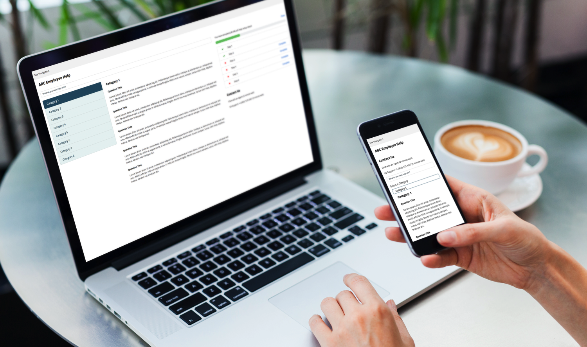

Slide 11
Feedback
"This will cause a complete paradigm shift once it is in use. I cannot wait to see it for real."
"This looks very good. Leaps and bounds better than the current system."
"The contact box is great. I like that multiple options are integrated."
"I can't wait for this to roll out, it looks great! It won't just make our role easier, but it'll reduce a lot of dead air and improve our customer interaction.
"...this will have a fundamental change on the level of support we can provide to our customers - I can't wait to see it go live!"
"This system will certainly improve the [Service Desk] analyst productivity and service levels."

Slide 12
Develop the Solution
This prototype was developed using Bootstrap4 and AngularJS. I first built the skeleton in basic HTML, utilizing the Bootstrap Grid System to enable responsiveness and noting where I could utilize AngularJS to separate the view and the logic.
I then went through and added AngularJS to the project, substituting static Category names and self-help question data with dynamic data defined in an AngularJS controller. I also added logic to show and calculate the Self-Help steps.

Slide 13
Project 1
Employee Idea Submission

Slide 14
Brief
The Idea Portal currently exists as a platform for employees to submit innovative solutions that will improve the operations of the company.
I was the primary User Experience Designer. In addition to completing a heuristic review of the existing portal, I interviewed many users of the current site to understand their pain points and difficulties in preparation for designing the new system.

Slide 15
Persona
Submitter
Primary Goals
Views submitted ideas
Comments on ideas
Votes on ideas
Submits ideas
Confidence
Low
Persona
Reviewer
Primary Goals
Reviews submitted ideas
Secondary Goals
Submitter Persona
Confidence
Low
Persona
General Admin
Primary Goals
Configure email messages
Secondary Goals
Reviewer Persona
Confidence
Medium
Persona
Champion
Primary Goals
Manage User Access
Secondary Goals
General Admin Persona
Confidence
High
Persona
Overall Admin
Primary Goals
Maintain and Configure Site
Secondary Goals
Champion
Confidence
Expert

Slide 16
Define the Problem
Submitters need to be able to easily submit ideas, track the status of ideas, and view submitted ideas.
Business Reviewers need to be able to easily review submitted ideas, while receiving meaningful notifications of required action.
General Admins need to be able to easily configure email messages, as well as approve ideas.
Innovation Champions need to be able to run campaigns, configure user access, and review ideas.
Overall Admins need to be able to maintain and configure the site, as well as manage user access and onboard and delegate new users of more experienced personas.

Slide 17
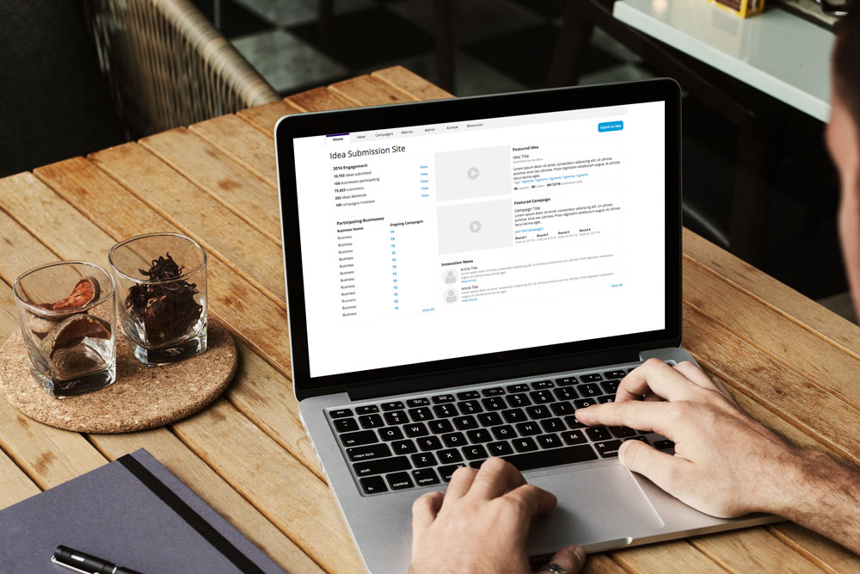

Slide 18
Project 1
Employee Vacation Tracker

Slide 19
Brief
The Employee Vacation Tracker allows employees to request time off through a simple interface, as well as view the time off of their team.
I was the User Experience Designer on this project. In addition to completing a heuristic review of the existing request system, I interviewed many users of the current site to understand their pain points and difficulties in preparation for designing the new tracker.

Slide 20
Primary User
Submitter
Primary Goal
Request time off through the portal and view upcoming time off and days remaining
Secondary Goal
Ability to view team’s upcoming time off
Secondary User
Approver
Primary Goal
Review and approve time off requests, and view direct reports’ upcoming time off
Secondary Goal
All tasks of Submitter persona

Slide 21
Define the Problem
Submitters need to be able to easily view upcoming time off, as well as request time off.
Approvers need to be able to easily view direct reports' vacation requests in order to approve vacation requests with minimal overlap.

Slide 22
